Slide 1
AN UPDATE ON INVESTMENT mediation - The State’s Perspective
Energy Charter Treaty Workshop
11 May 2017 - Brussels
Anna Joubin-Bret
Avocat à la Cour
Cabinet Joubin-Bret
Paris

Slide 2
Outline
The reasons for proposing mediation as an alternative to ISDS
  Mediation offers: the treaties allow but are not conducive
  A recent trend in investment treaties: Investor-State Mediation (ISM) provisions
  ISM Rules and a comprehensive offer for mediation
Key issues for State representatives
Reaching, drafting and enforcing an agreed outcome

Slide 3
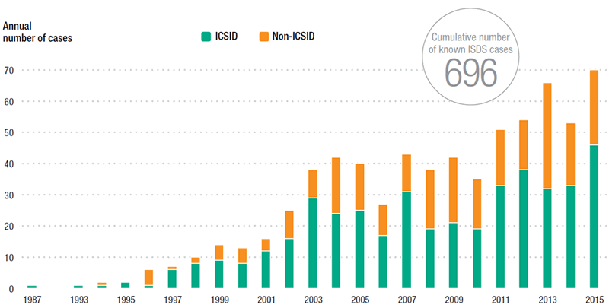
Known Investor-State cases for 2016
Known ISDS cases, 1987-2015
Source: ©UNCTAD, ISDS Navigator

Slide 4
The specific nature of investor-State dispute settlement
They involve measures taken by a sovereign State at the central, regional or municipal levels). The State is ALWAYS the defendent in these cases;
The dispute is subjected to international law;
Recourse to international arbitration is among the options an investor can choose from;
The relationship between investors and host States are meant to be long term investments.
A final award granting compensation defeats the purpose of investment promotion;
The amounts to defend the cases and final awards are very high and involve public money..

Slide 5
Advantages/disadvantages of ISMediation
Disadvantages of mediation
Advantages
Dilatory/waste of time and money
Limited capacity and expertise
Finality of an arbitral award
Enforceability?
Responsibility for government officials
Accountability: binding decision
Not suitable for all types of disputes
Limited costs
Limited time frame
Control for the State over the process
Response to concerns about ISDS?
Safeguards the investment relationship: win/win
Alternative outcomes/not only monetary compensation
Flexibility
Process supported by treaty and rules

Slide 6
Mediation offers in IIAs
1st requirement: the treaty must allow/offer mediation
A growing number of IIAs: Specific wording referring to mediation/conciliation as a method to reach amicable settlement during the “cooling-off” period.
Ex: the US model treaty.
Ex.: the ECT

Slide 7
Recent trend: stand-alone mediation provisions in IIAs
A recent trend: Stand-alone mediation provisions in IIAs
  Mediation annex in draft EU-Canada CETA
  Mediation/conciliation in the ASEAN ACIA
  The revised Investment Treaty of the Arab League of January 2013
  The COMESA CCIA
  In model BITs and recent treaties: the Thai model BIT of 2012

Slide 8
ISM-specific rules: treaty-based or Stand-alone ?
The Canada-EU CETA annex on mediation: detailed rules in the treaty
India model treaty.
The IBA investor-State mediation rules
The UNCITRAL Rules on conciliation (in fact mediation rules)
The ICSID Rules on conciliation
New ICC Mediation Rules
Drafting treaty-specific mediation rules
Reference to general or specific rules
Recommendation: guide the parties. Allow for changes.

Slide 9
Reaching an agreement
Need for a framework to enable government officials
Need for clear accountability rules
Importance of having the right representative(s)
Specific procedures for approval need to be made clear at the outset
Internal preparation and procedure
Bureaucracy/decision-making
Choice of an experienced and knowledgeable mediator is essential
Support by an arbitration/mediation institution: crucial

Slide 10
Drafting and enforcing th agreement
The role of lawyers: in-house counsel, external counsel, government lawyers.
Link with an investment arbitration - pending/waived/without prejudice
The settlement agreement: monetary settlement, restitution, undertaking to perform,…
The underlying treaty obligations: important to refer to the potential treaty violations. Settlement is compensation but settlement does not entail recognition of violation
The UNCITRAL enforcement rules – Working Group II.

Slide 11
THANK - YOU
Contact:
Anna Joubin-Bret
Cabinet Joubin-Bret
4 bis rue du Colonel Moll
75017 Paris
ajb@joubin-bret.com
www.joubin-bret.com

