Slide 1
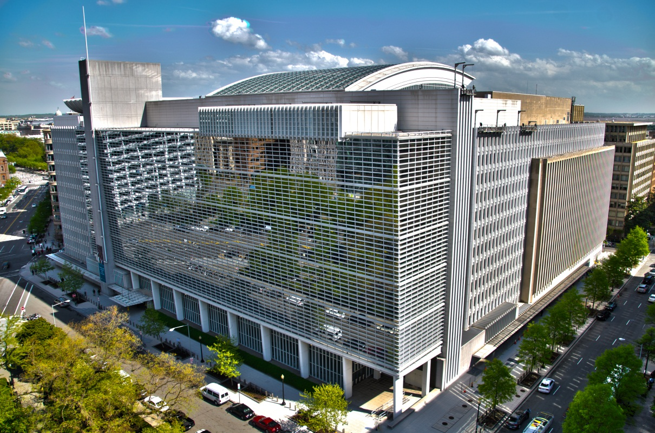
ICSID Conciliation
Frauke Nitschke, Team Leader/Senior Counsel, ICSID
May 11, 2017
Brussels, Belgium

Slide 2
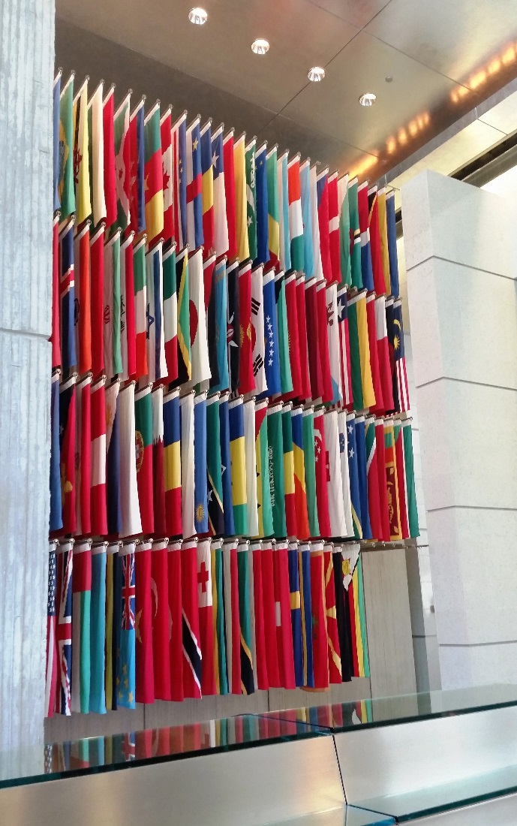
ICSID – Who are we and what do we do?
International Organization, 1 of the 5 World Bank Group institutions
153 Member States
ICSID offers facilities and procedures to resolve investment disputes between States and foreign nationals
608 ICSID arbitration & conciliation cases registered

Slide 3
ICSID Services & Rules
Convention (1966)
Both disputing parties from ICSID Member States
Conciliation
Arbitration
Additional Facility (1978)
One disputing party from Member States
Conciliation
Arbitration
Other
Need not be from Member State
Case administration under other Rules or Treaties (e.g.: UNCITRAL or other investment cases; FTA & State-to-State cases)
Other functions on consent of parties (e.g.: Appointing Authority, Mediation, Conciliation, Fact-Finding Registry)
Fact-finding
Acting as Secretariat for Regional Trade Agreements (e.g.: CETA Ch. 8)

Slide 4
ICSID Conciliation in the ECT
Article 26(4)(a):
“In the event that an Investor chooses to submit the dispute for resolution under subparagraph (2)(c), the Investor shall further provide its consent in writing for the dispute to be submitted to: (…)
  The International Centre for Settlement of Investment Disputes, established pursuant to the [ICSID Convention] (…); or
  The International Centre for Settlement of Investment Disputes, established pursuant to the Convention referred to in subparagraph (a)(i), under the rules governing the Additional Facility (…)”

Slide 5
ICSID Convention Conciliation
Cooperative, non-adversarial dispute-resolution process
“It shall be the duty of the Commission to clarify the issues in dispute between the parties and to endeavour to bring about agreement between them upon mutually acceptable terms. To that end, the Commission may at any stage of the proceedings and from time to time recommend terms of settlement to the parties. The parties shall cooperate in good faith with the Commission in order to enable the Commission to carry out its functions, and shall give their most serious consideration to its recommendations.”
(ICSID Convention, Article 34)
Notes:
SP - Relevant provisions:
ICSID Convention Articles 28 to 35
Institution Rules
Conciliation Rules
Administrative and Financial Regulations

Slide 6
ICSID Conciliation & ICSID Arbitration – Similarities
Consent is binding upon the parties, may not be withdrawn unilaterally
Jurisdictional requirements of ICSID Convention Art. 25 apply (legal dispute between Member State & national from Member State arising directly out of an investment / written consent to ICSID jurisdiction)
Certain procedural aspects mirror arbitration:
  Request & registration
  Method of constituting the conciliation commission
  Default procedure for appointments and filling of vacancies
  Qualifications of conciliators

Slide 7
ICSID Conciliation & ICSID Arbitration – Differences
ICSID Arbitration
ICSID Conciliation
Seeks to resolve parties’ dispute through a Tribunal
Tribunal has power to impose a final, binding and enforceable decision to resolve dispute
Adversarial procedural frame
Tribunal decides on the allocation of costs
Seeks to bring the parties to an agreed settlement
Conciliation Commission has no power to impose its recommendations
Non-adversarial framework, flexible
Fees and expenses of the proceeding are borne equally by the parties

Slide 8
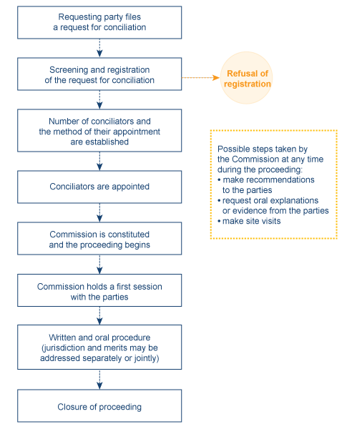
Conduct of an ICSID Conciliation
Notes:
Conciliation Procedure
ICSID Conciliation Rules 22 and 23
The Conciliation Commission may ask the parties for:
relevant documents or explanations;
hear witnesses and experts;
make site visits;
issue recommendations at any time during the proceeding; and
request evidence from other person

Slide 9
Report of the Conciliation Commission
The Commission issues a report
In its Report the Commission may:
  record a party’s failure to appear or participate;
  decline jurisdiction;
  record the parties’ failure to reach an agreement; or
  record the parties’ agreement

Slide 10
Conciliation – Empirical Data
ICSID has registered a total of 10 conciliations:
  8 under the ICSID Convention (one is pending)
  2 under the Additional Facility Rules (one is pending)
  Most cases were brought on the basis of investment contracts; none under the ECT thus far
  8 cases involved States from Sub-Saharan Africa

Slide 11
Conciliation Proceedings under the ICSID Convention and Additional Facility - Outcomes
Notes:
Commission Reports
Report recording failure of the Parties to reach agreement
83%
Report recording agreement of the Parties
17%

Slide 12
Conciliation Proceedings under the ICSID Convention and Additional Facility - Outcomes
Notes:
Commission Reports
Report recording failure of the Parties to reach agreement
83%
Report recording agreement of the Parties
17%

Slide 13
Big Picture:
Settlement of Investment Disputes

Slide 14
Amicable Settlement & Arbitration
Big Picture & Practical Examples
Conciliation/Mediation as a Stand Alone Process
Conciliation/Mediation prior to ICSID Arbitration (e.g., 2-tier dispute settlement clause)
Conciliation/Mediation after an Award has been rendered
Conciliation/Mediation during ICSID Arbitration

Slide 15
ICSID Conciliation & Arbitration of the Same Dispute
Question: Can there be an ICSID Conciliation/Mediation alongside an ICSID Arbitration?

Slide 16
ICSID Convention, Article 26
“Consent of the parties to arbitration under this Convention shall, unless otherwise stated, be deemed consent to such arbitration to the exclusion of any other remedy.”
Question: Can there be Conciliation alongside ICSID Arbitration?
  Answer: Yes. Parties may pursue ICSID Conciliation once an ICSID arbitration proceeding has commenced

Slide 17
Big Picture:
Settlement Rates in ICSID Arbitration

Slide 18
ICSID and Mediation
  ICSID offers support to/stands ready to administer investor-State mediations:
    Offers facilities
    Provides expert support from its staff
    Financial administration
    Training Course for mediators & government officials
      Washington, D.C., June 12-14, 2017
    Investor-State Mediation included in the Introduction to ICSID Procedure Course

Slide 19
ICSID and Mediation
    ICSID part of IMI task force on Investor-State Mediation
    ICSID provides platform for intellectual discourse on mediation:
      Issue of ICSID Review-FILJ dedicated to investor-State mediation
Reviewing framework of ICSID dispute settlement to (Rule amendment process)

Slide 20
ICSID
1818 H Street, NW
Washington, DC 20433
Tel: (202) 458-1534
Fax: (202) 522-2615
Email: icsidsecretariat@worldbank.org https://icsid.worldbank.org

